Slide 1
Modern Release Patterns and Practices
AgileIndy
March 13, 2019

Slide 2
Agenda
Introduction
What is DevOps?
Kaya Records – Problem Domain
Drive Toward Excellence
Conclusion

Slide 3
Introduction

Slide 4
Introduction
What This Is
Brief introduction to DevOps at a high level
Presentation of fictitious company in need of DevOps help
Presentation of battle-tested modern release patterns and practices
What This Is NOT
A full DevOps 101
A silver bullet

Slide 5
Why Listen to Me?
West Point graduate
Led 50+ teams, sized from 3 to 150+
DevOps Coach
Multiple DevOps transformations at household name clients
“Honest broker”

Slide 6
What is DevOps?

Slide 7
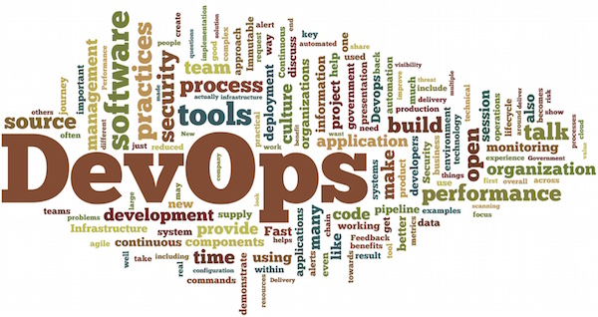

Slide 8
DevOps is a Transformation
People
Culture
Training
Process
Workflow
Automation
Tools
SCM/VCS
Config
Expert Help
Pipelines
Etc…
Testing

Slide 9
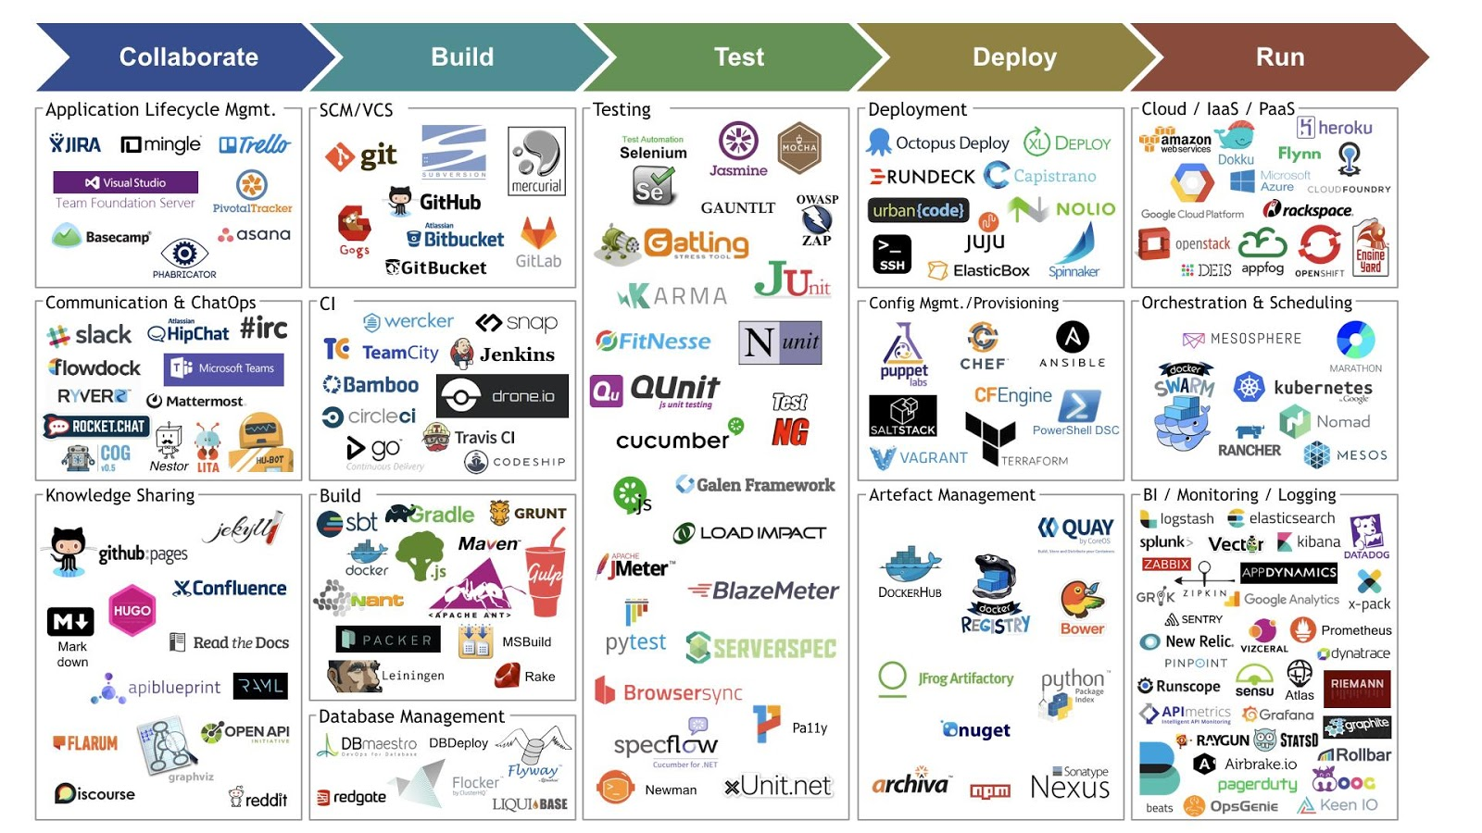

Slide 10
Leadership
People
Culture
Training
Process
Workflow
Automation
Tools
SCM/VCS
Config
Expert Help
Pipelines
Etc…
Testing
Communication

Slide 11

The Infinity Loop

Slide 12
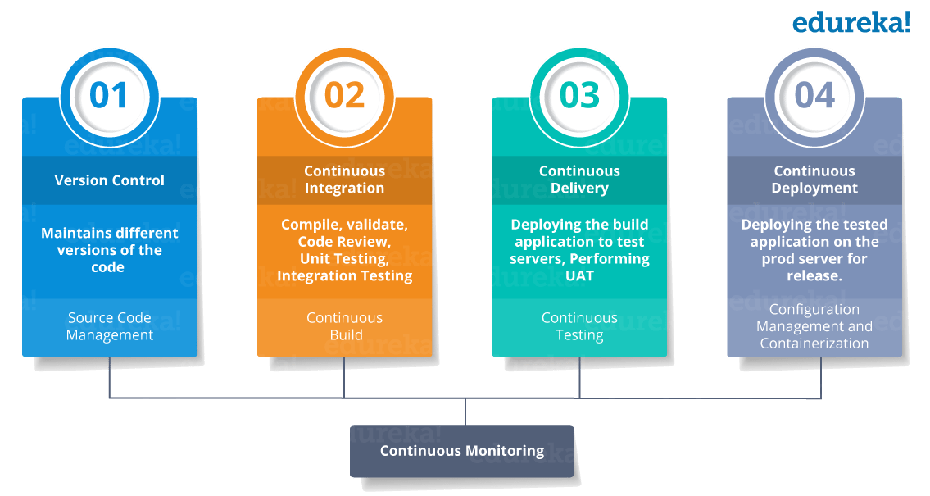
CI / CD / CD

Slide 13
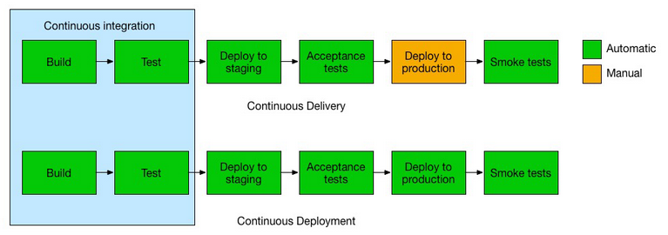
CI / CD / CD

Slide 14
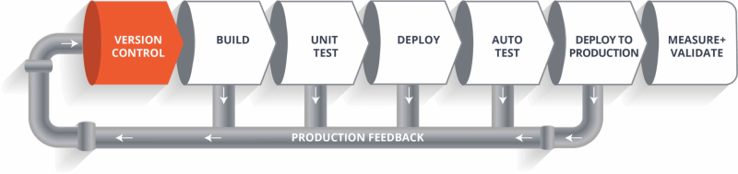
Pipelines

Slide 15
Kaya Records

Slide 16
Problem Domain
Driving Forces
Digital Transformation
Digital Disruption
Time-to-Market
Cost optimization
Cloud Solution
Low cost of entry
Fast innovation

Slide 17
Problem Domain
Want to move from a focus on RESOURCE OPTIMIZATION to a focus on TIME TO MARKET
99% of all organizations are optimized on resources, better known as PEOPLE
Everyone that does the same thing is on the same team
People are interchangeable
Well defined process drives delivery to ensure predictability
Hierarchical, top-down environment with very little empowerment
Departments are silos
Multi-skill “collaboration” requires tickets and approvals
Future State: Multi-functional team
Automation drives predictability
Self-organizing teams
Silos are knocked down
Collaboration is through Agile and DevOps concepts

Slide 18

Introducing Kaya Records
Music Store Company / Sells Vinyl Records
Has an Online Shop / Needs to Compete Now

Slide 19
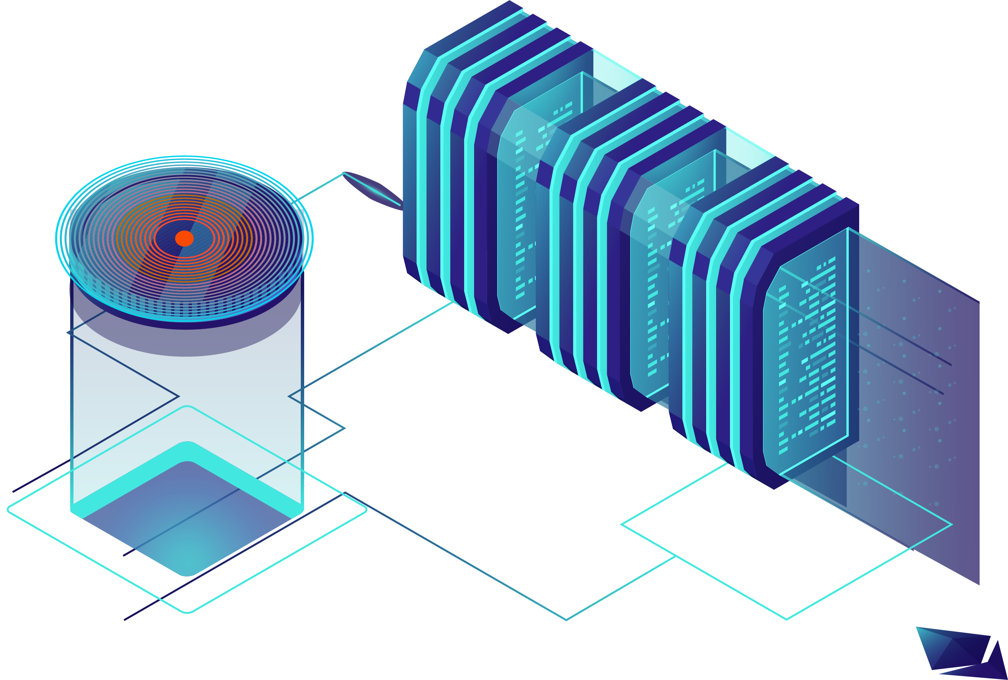
Issues
New Investment Needed in Data Center

Slide 20
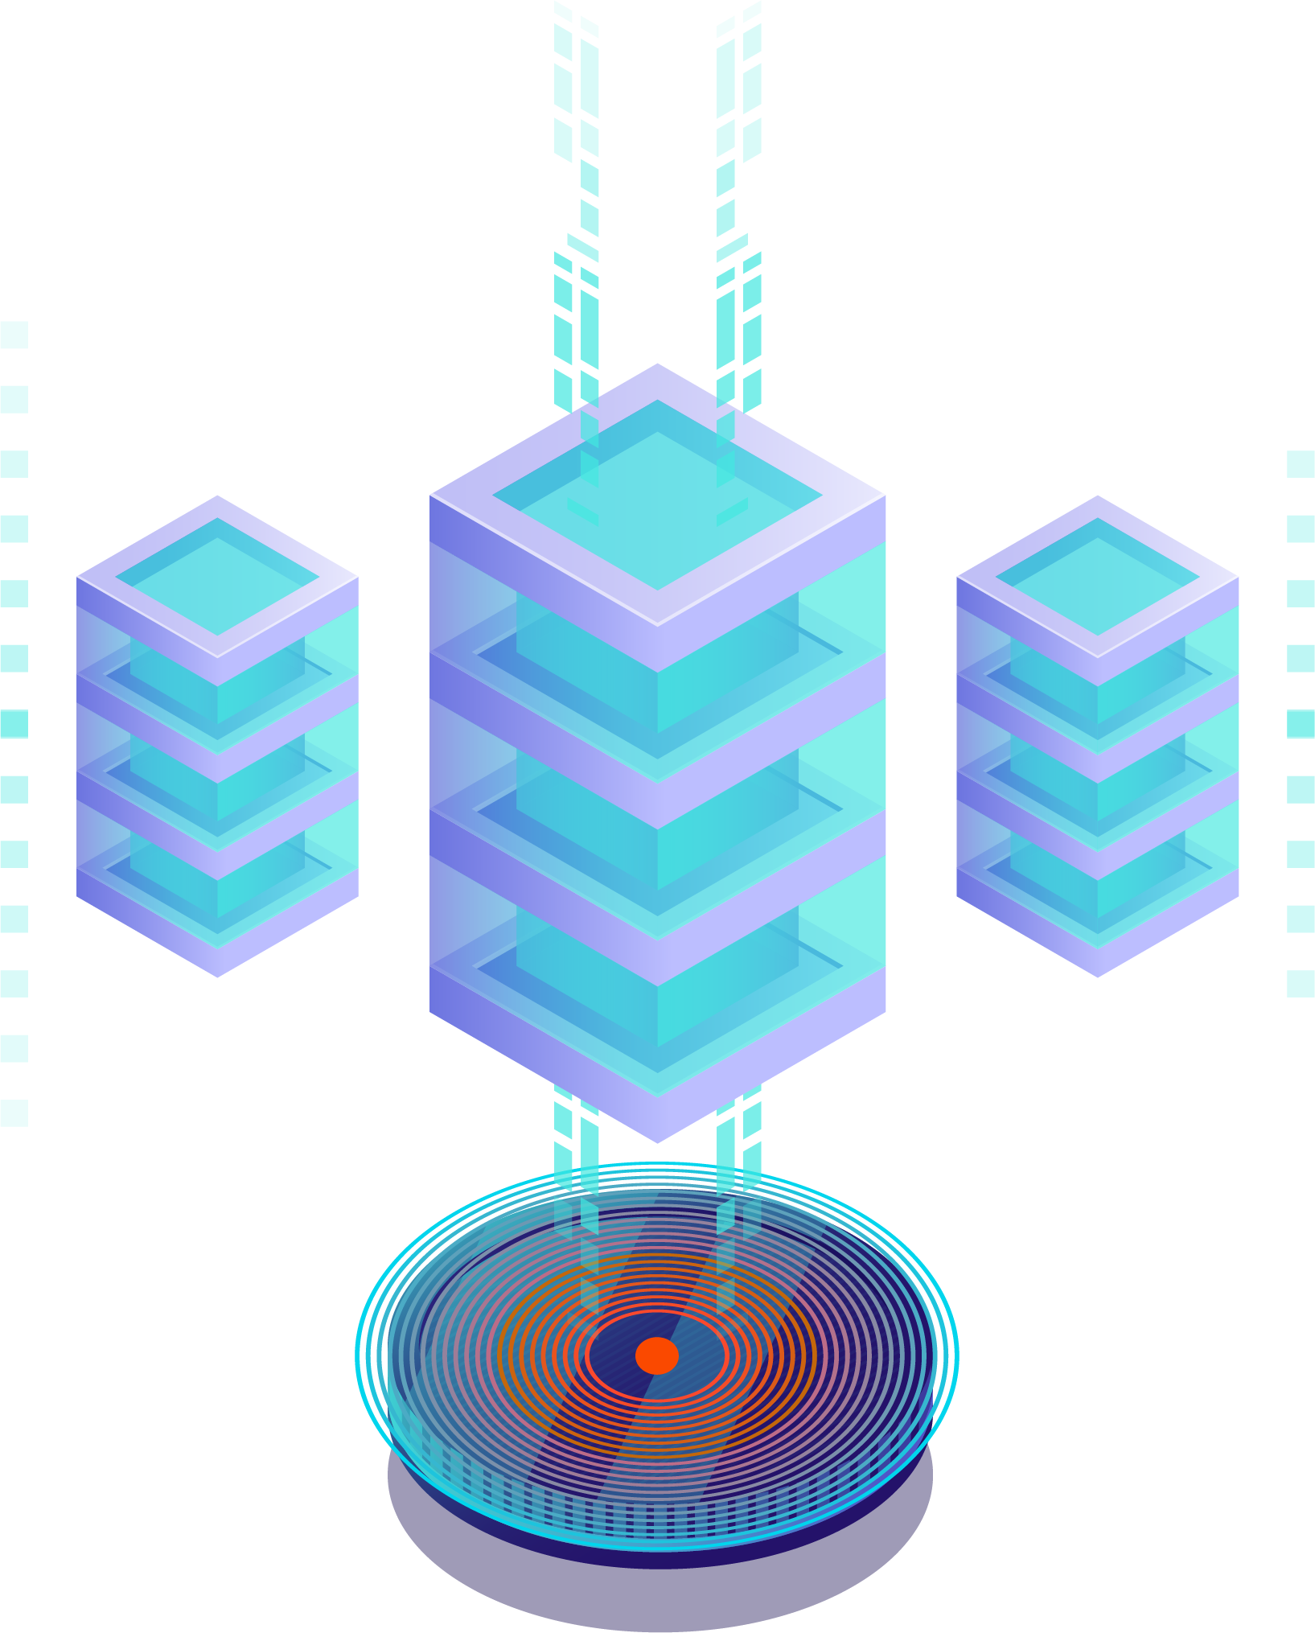
Issues
Hard to Make Changes to the Current Application

Slide 21
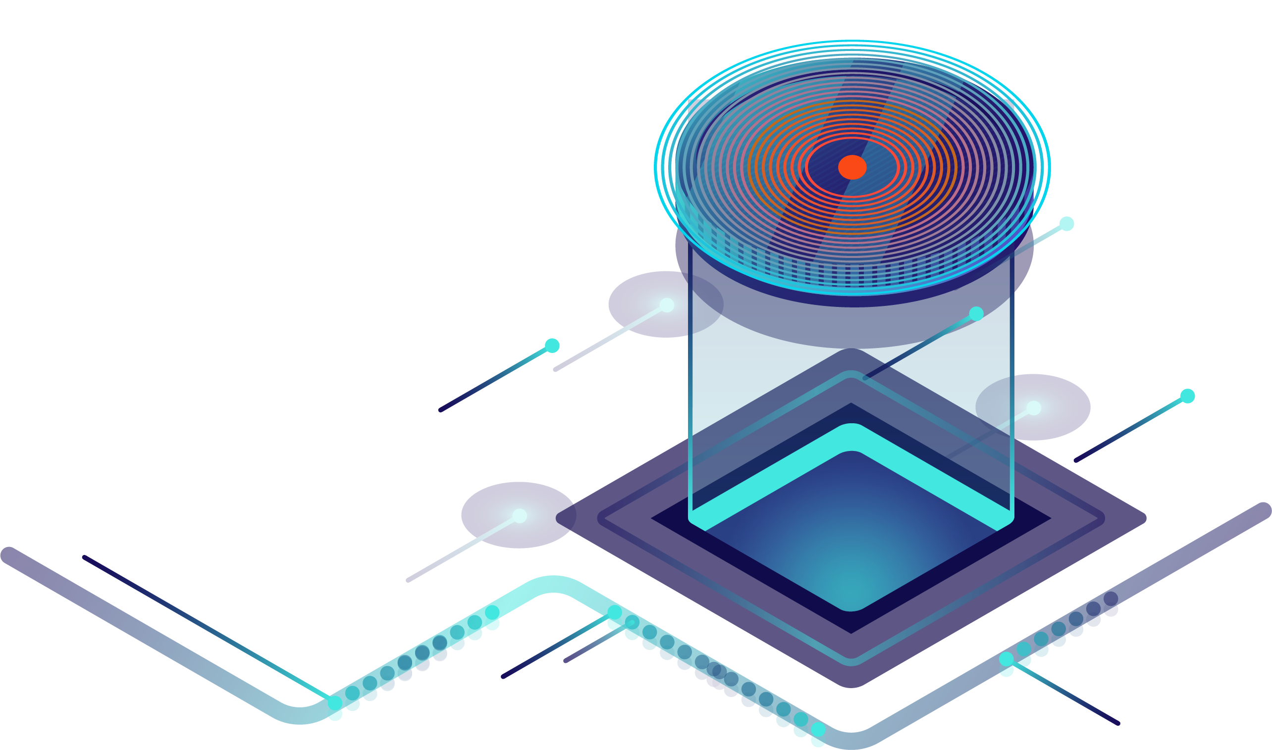
Issues
Any Significant Change (Release) Requires Downtime

Slide 22
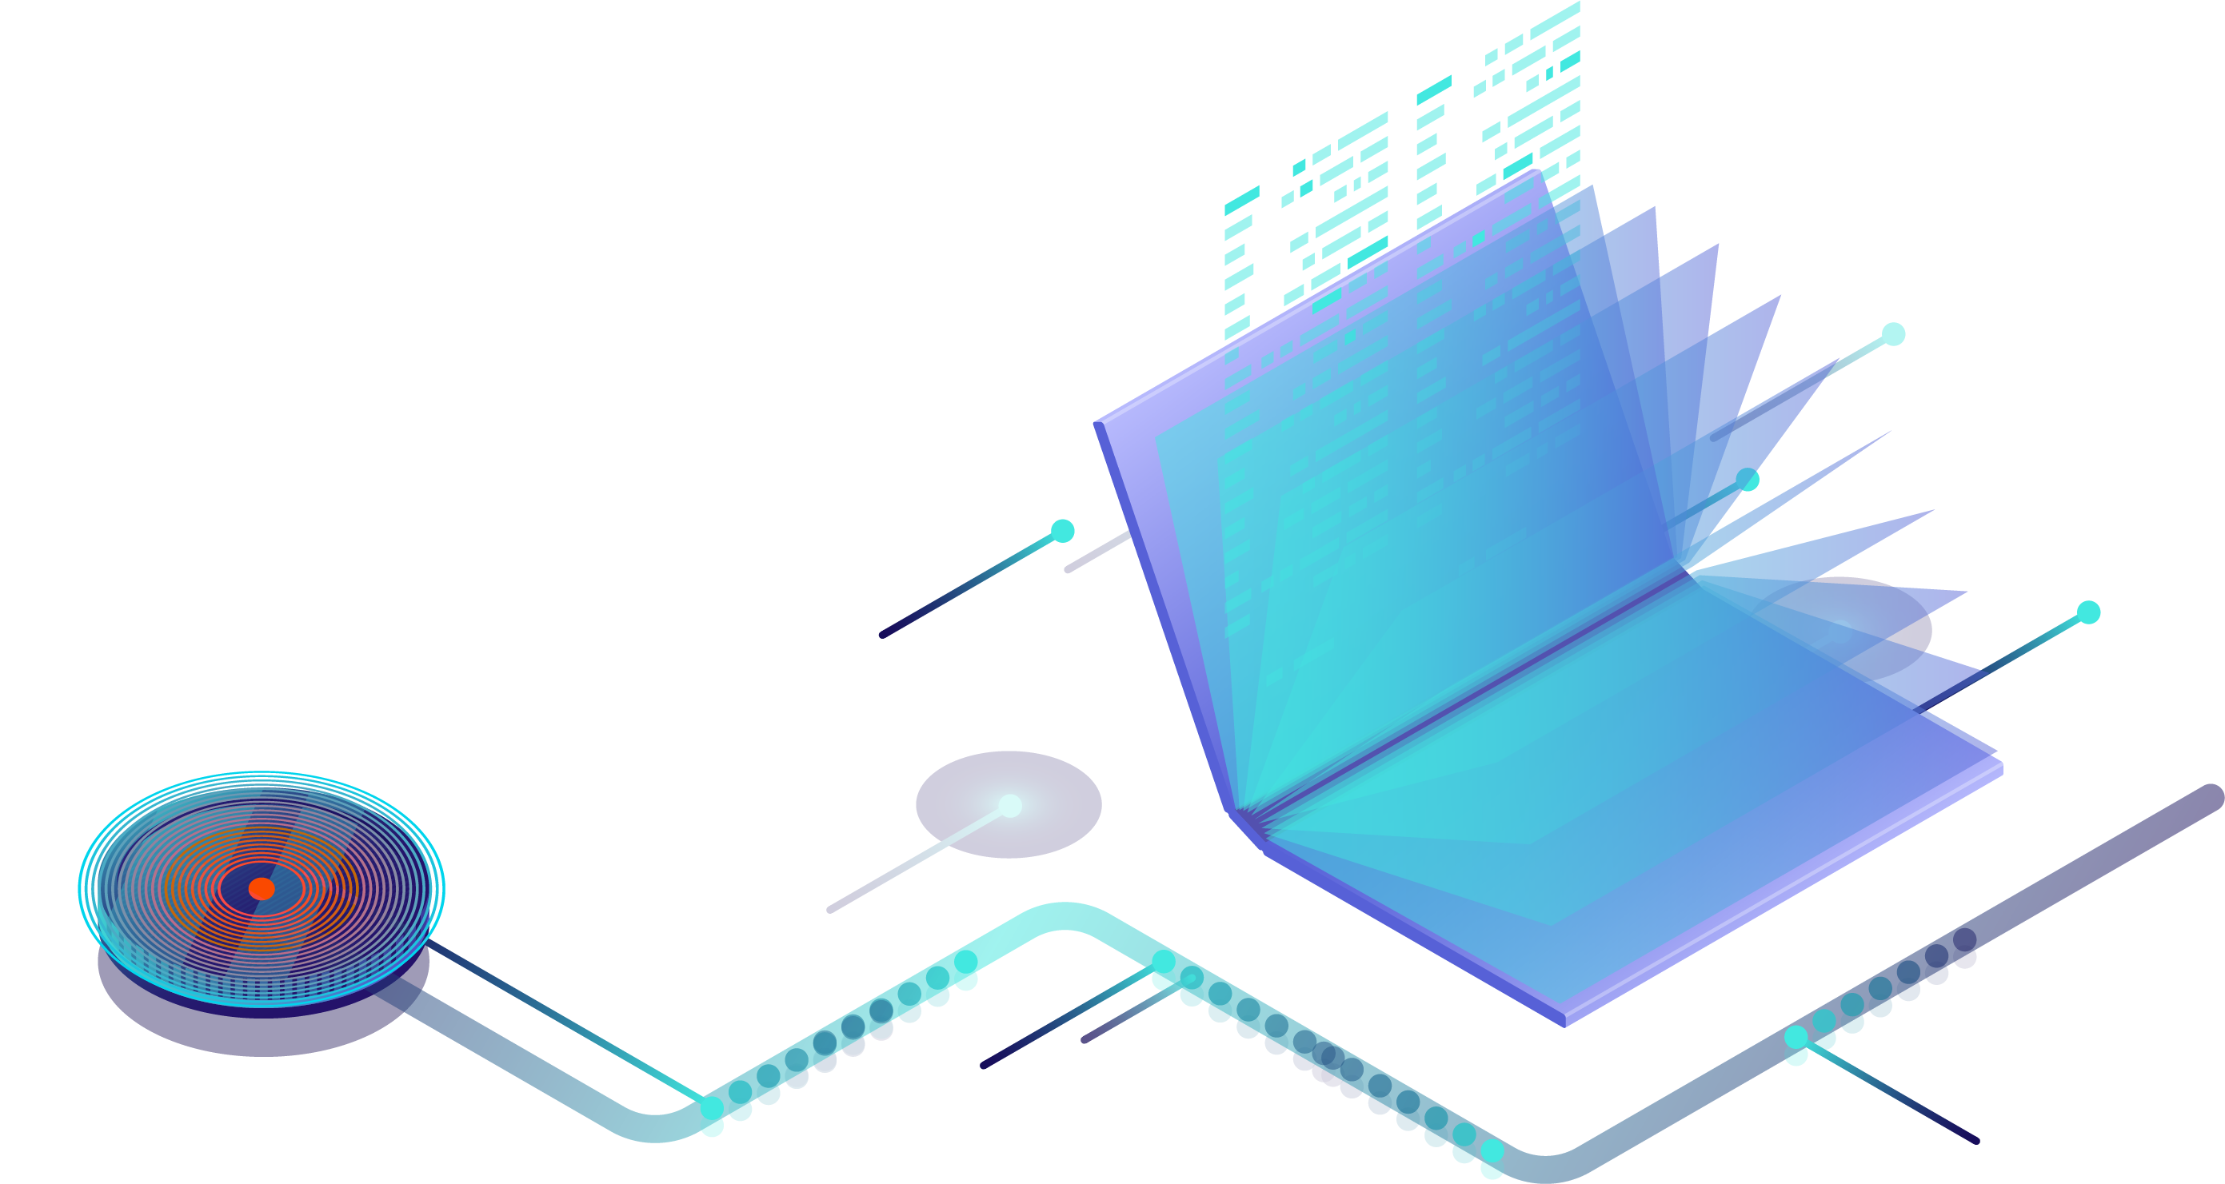
Issues
Hard to compete – need to change the business model
Sell other products
Subscription services
???

Slide 23
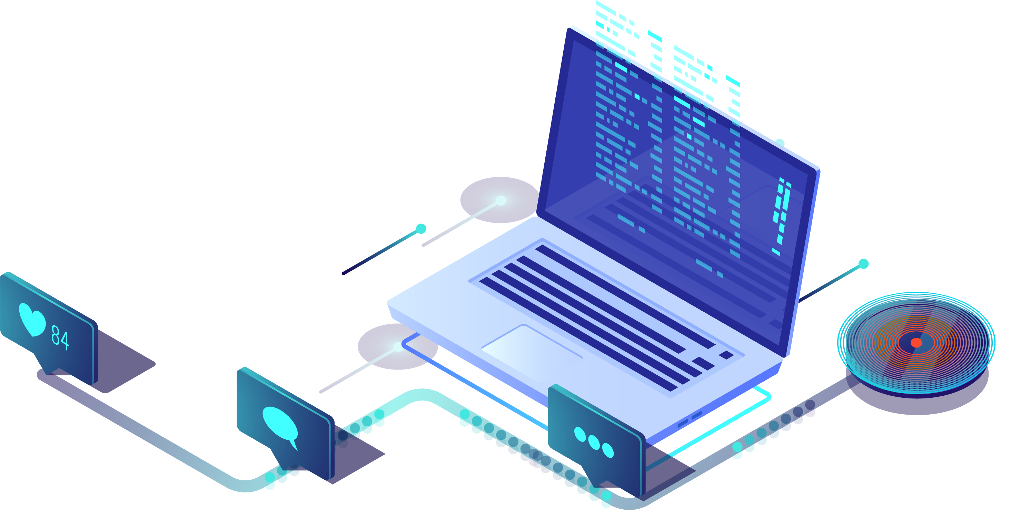
Issues
Customer Feedback – Online Shop is Slow and Outdated
Need a complete overhaul of the online system

Slide 24
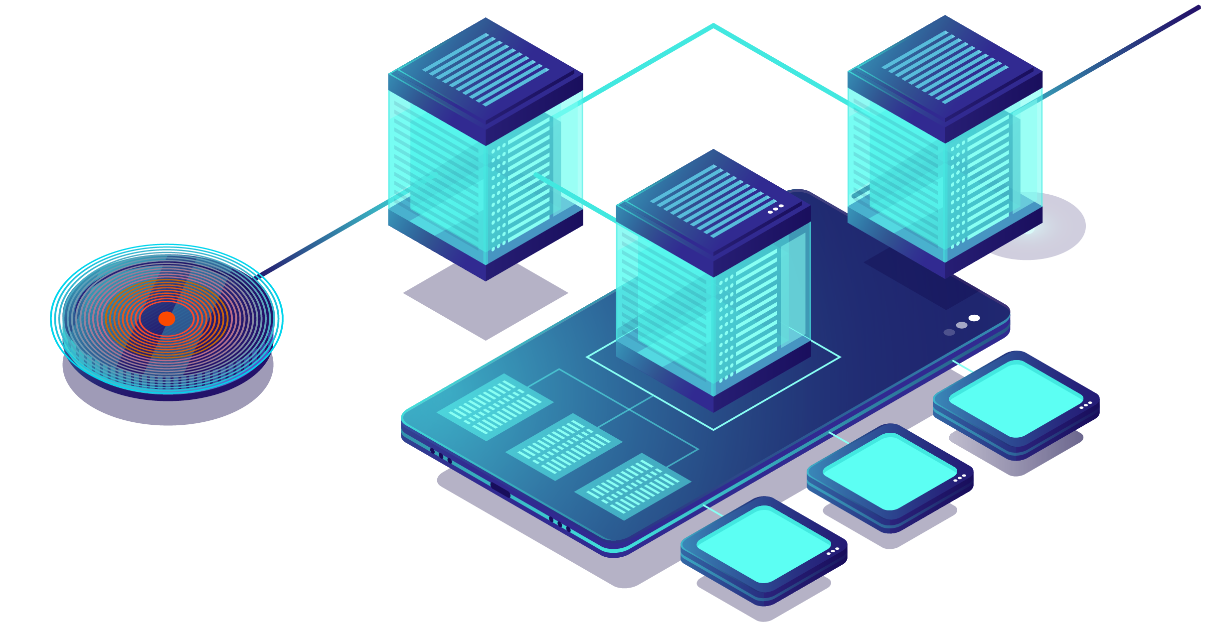
Strategy
Move to a DevOps Mindset
Customer-centric approach to software
Highest priority is Time to Market
Flexibility and power to satisfy customers FAST

Slide 25
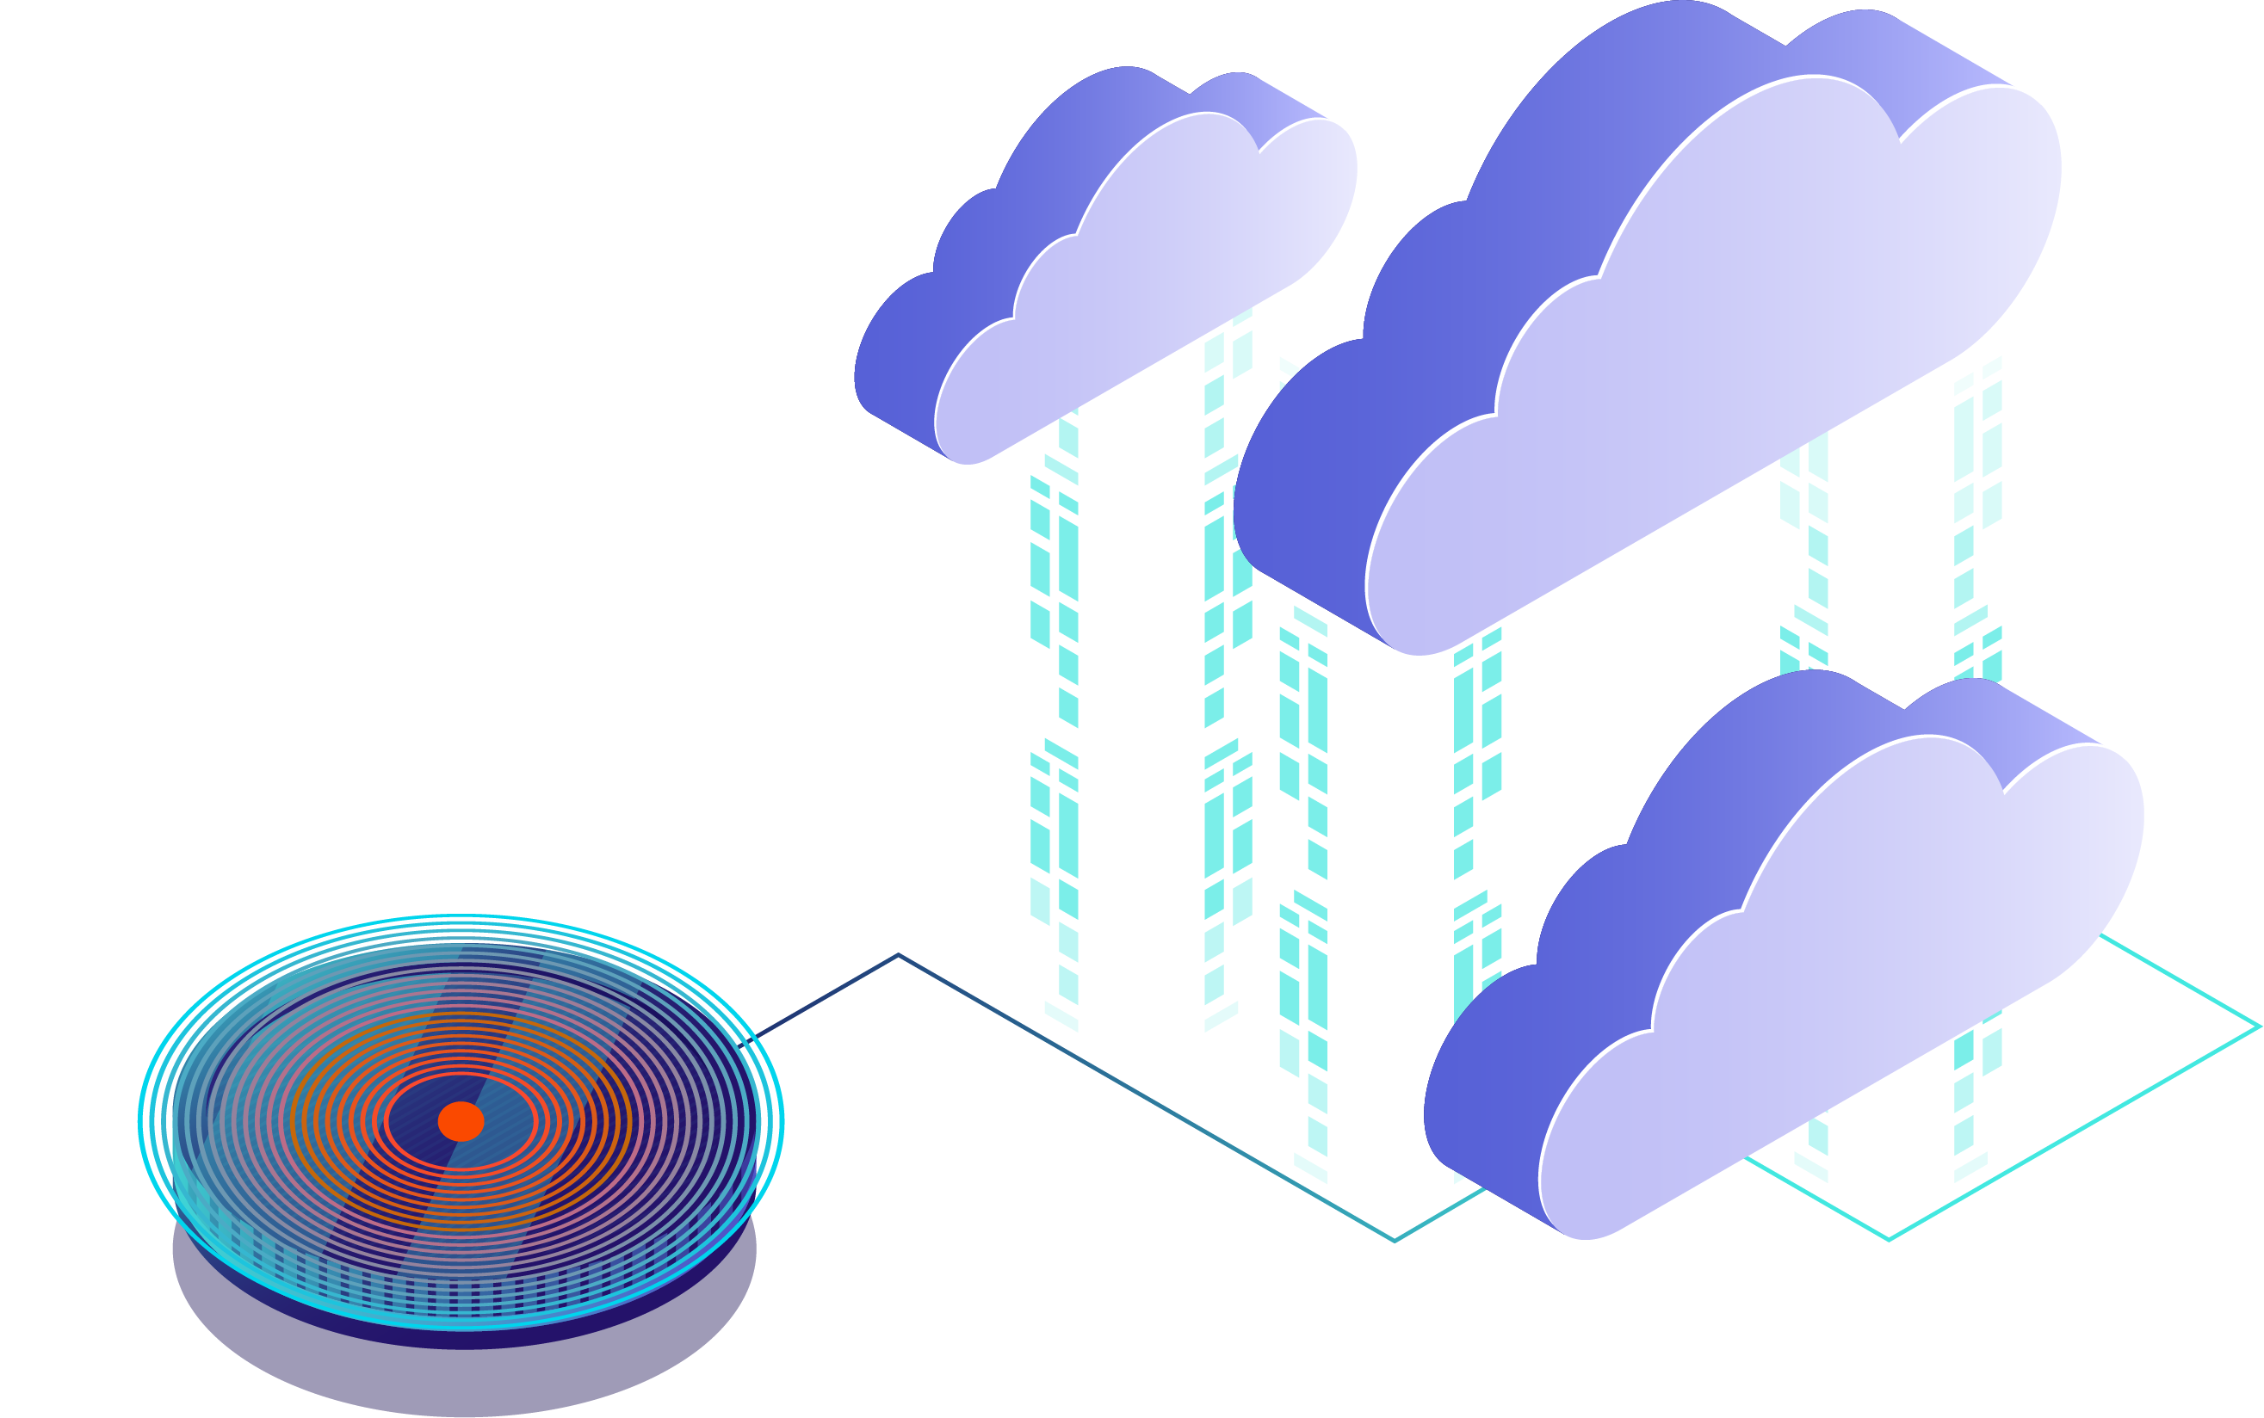
Strategy
Move From On-Prem to the Cloud
Use cloud as a transformation accelerator

Slide 26
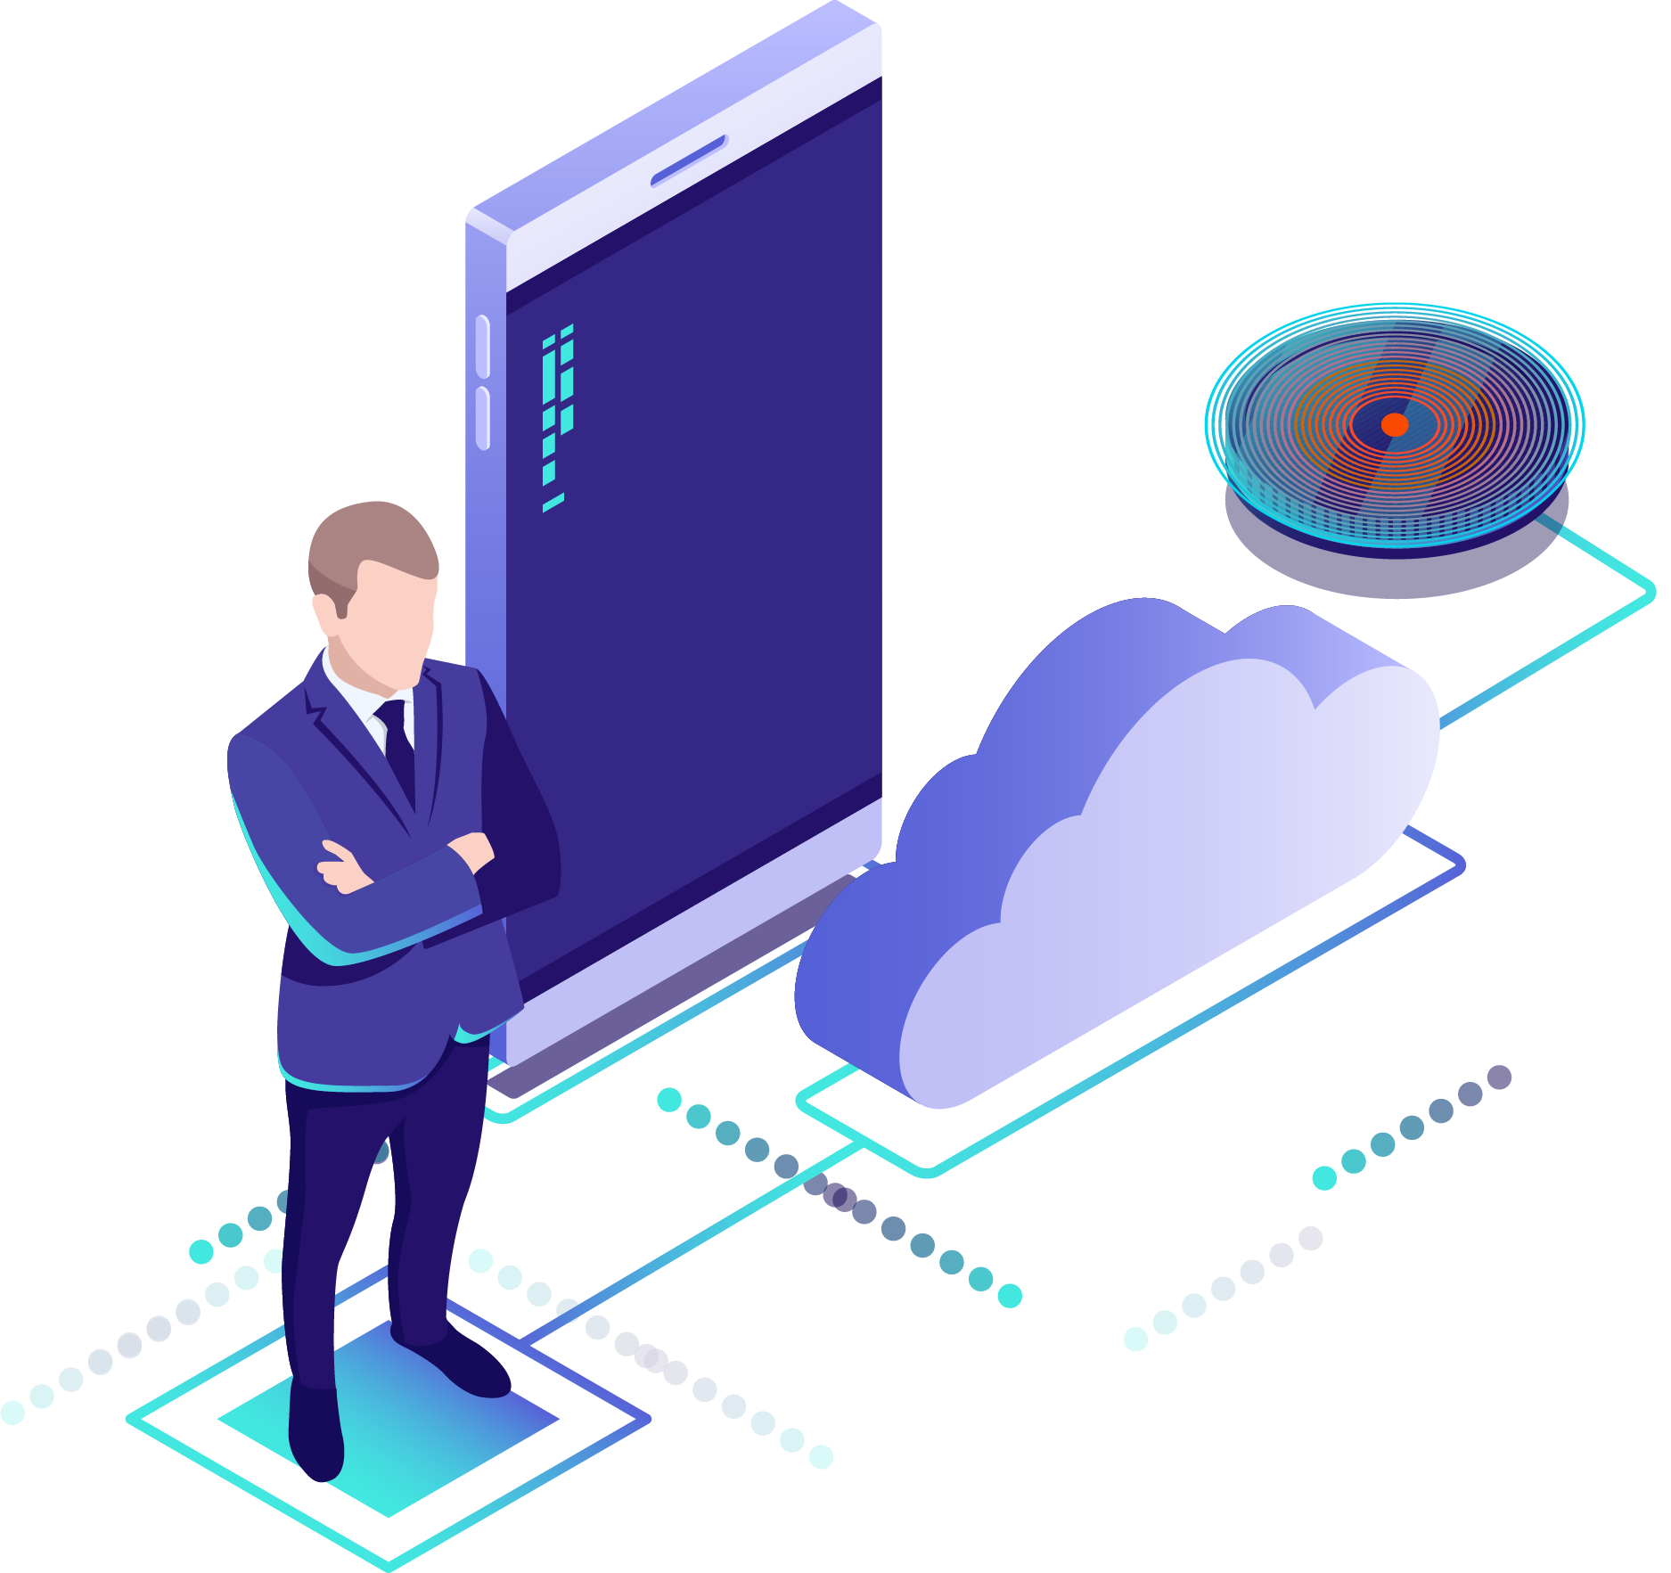
Strategy
DevOps Transformation Requires a Combination of:
People
Process
Tools
Leadership
Communication

Slide 27
Drive Toward Excellence

Slide 28
Optimize Value Delivery
Step 1: Assess the current situation
Step 2: Attack the biggest pain point or bottleneck
Step 3: Repeat Steps 1 and 2

Slide 29

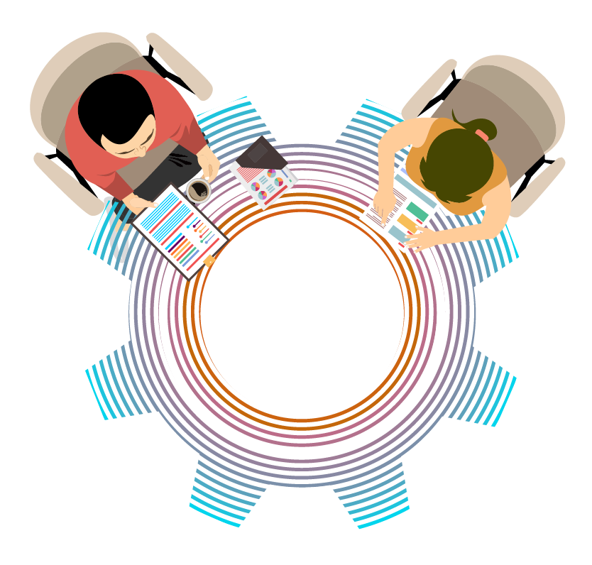


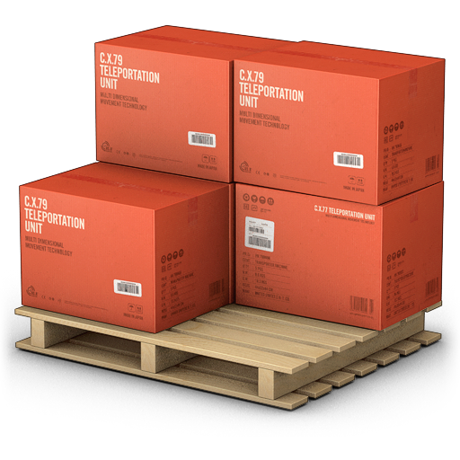
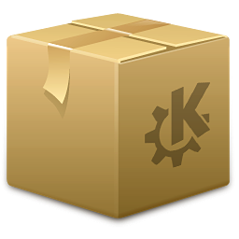
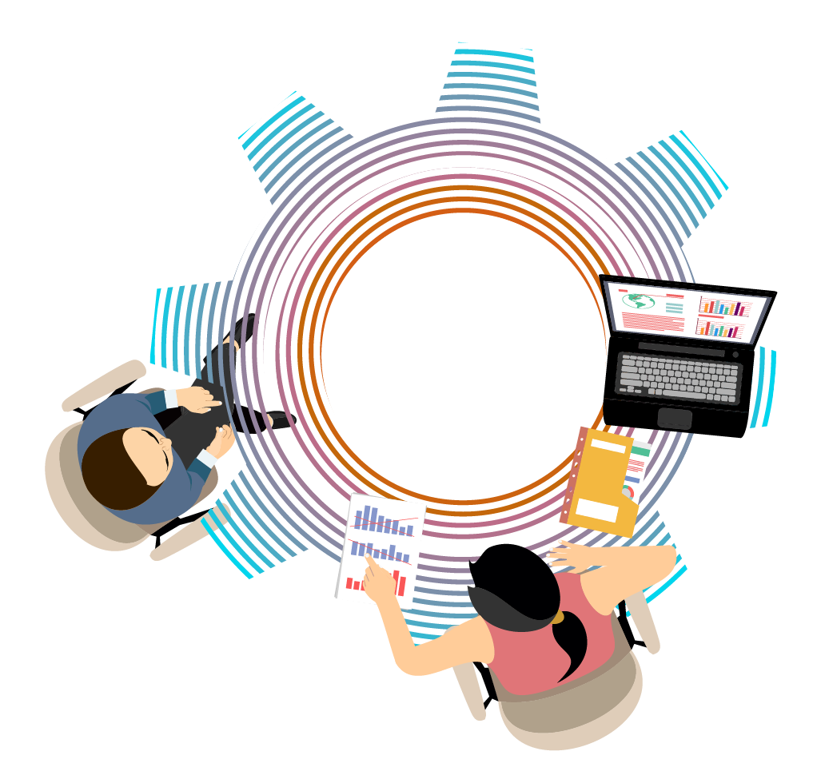
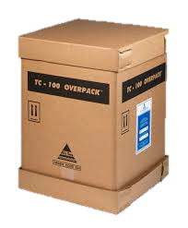


Mission #1: Organization and Flow
CURRENT ORGANIZATION
CLEAR API’S
SELF SERVICE
DEV
TEAM
RISK
COMPLIANCE
TEAM
AUTOMATION
API
REQUIREMENTS
TEAM
METERING
OPS
TEAM
TEST
TEAM
ETC…
SILOS
SPECIFIC
RESPONSIBILLITY
COST DRIVEN
NO AUTONOMY
PROJECT TEAMS
NO FLOW

Slide 30




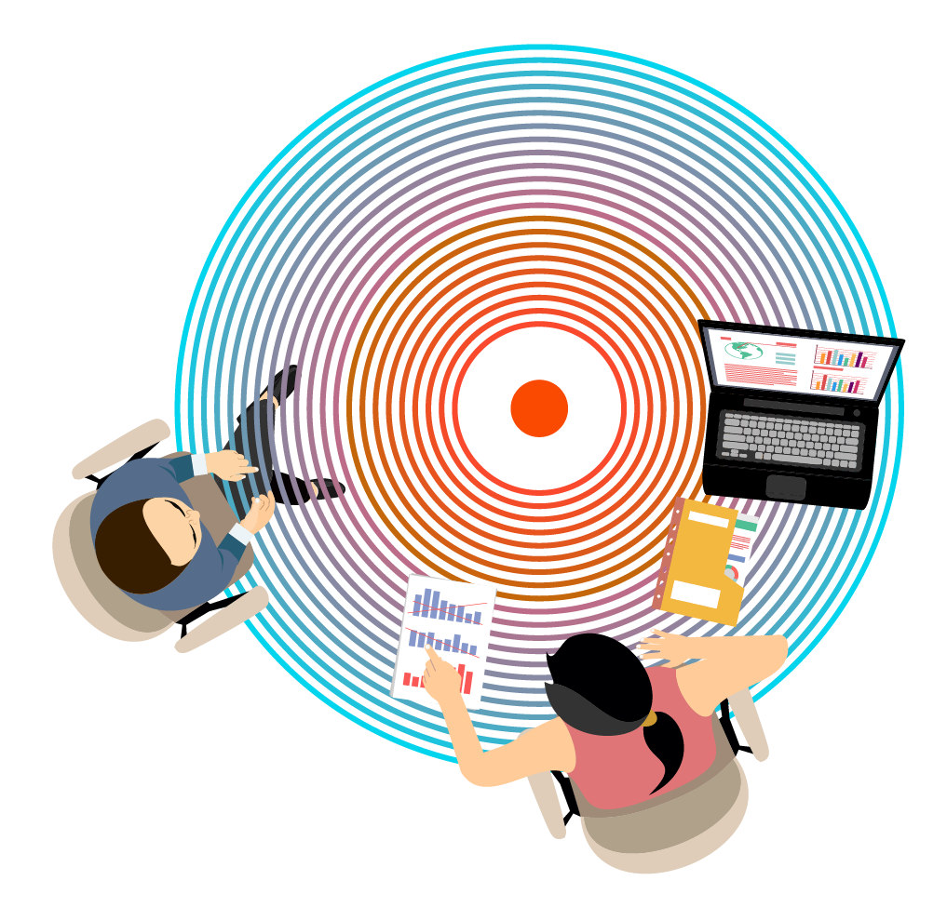

Mission #1: Organization and Flow
ORGANIZATIONAL CHANGES TO GET TO DEVOPS
SHOPPING BASKET TEAM
CATALOG TEAM
SEARCH TEAM
SHIPPING TEAM
PLATFORM TEAM
API
SELF SERVICE
CLEAR API’S
METERING
AUTOMATION
ETC…
INTELLIGENT INFRASTRUCTURE PLATFORM
MISSION COMMAND
END TO END
CROSS-FUNCTIONAL
VALUE DRIVEN
AUTONOMOUS
PRODUCT TEAMS

Slide 31
Mission #2: Data Center and Agility
Inertia of IT Ops in Current Data Center
High Level of Governance
Physical Servers
Minimal Agility
CAPEX process for scale out
Backyard mechanic process for scale up
Downtime for every release

Slide 32
Mission #2: Data Center and Agility
Solution: Move to Public Cloud
Model Change from CAPEX to OPEX
Flexibility for Scale Up and Out
Zero Downtime
Retooling for Cloud
Step 1: Move Existing Web Site to the Cloud

Slide 33
Mission #3: Tooling and Automation
Automation, Automation, Automations
Automate as much as you can
Automate as early as you can
Need for Repeatable and Reliable Deployments
Choose Microsoft Toolset
Azure
Azure DevOps
Azure Resource Manager (ARM) Templates
CI – Every Commit Triggers a Full Build
CD – On Every Build, to Azure

Slide 34
Assessment
Where are We?
Value Stream Based Teams
Fully Automated Build
Fully Automated Deployment to Azure App Services for Lower Environments
What Is Next?
Improve Developer Flow for Stable Deployments
Introduce Feature Toggles

Slide 35
Mission #4: Feature Toggles
Culture of Experimentation – GOOD
Unfinished or Untested Code is Making it Into Production
This Results in Live Site Incidents (LSIs) - BAD
Rollback Process is Slow and High-Touch

Slide 36
Mission #4: Feature Toggles
When you want to ship often, how do you cope with code that is not finished or tested?
Traditionally, you use feature branches to isolate
What if you want to ship weekly, or even daily? Feature branches will slow everything down.
Solution 1: Break up changes into independent parts that can be released separately (current mission)
Use feature toggles/flags to enable or disable features
Give business control over who gets which feature
Solution 2: Microservices (future)
Solution 3: Slot deployments (future)

Slide 37
Mission #4: Feature Toggles
Do not build your own – there are many options already out there:
If-Else
Nfeature
Feature Toggle
Feature Switcher
Flipit

Slide 38
Mission #4: Feature Toggles
LONGEVITY
YEARS
MONTHS
WEEKS
DAYS
PERMISSION TOGGLES
OPS TOGGLES
EXPERIMENT TOGGLES
RELEASE TOGGLES
DYNAMISM
CHANGES WITH A DEPLOYMENT
CHANGES WITH RUNTIME RE-CONFIGURATION
CHANGES WITH EACH REQUEST

Slide 39
Mission #4: Feature Toggles
Final points about Feature Toggles
Feature Toggles need to be maintained!
As soon as you do not need them, get rid of them
If you keep them around, you produce Technical Debt

Slide 40
Assessment
Where are We?
Faster and More Stable Deployments
Issue: There is still downtime at the moment of release
What Is Next?
Blue/Green Deployments
Deploy to New Environment
When Deployment is Done, Slowly Move Traffic to New Environment
Eliminates Downtime
Improves Ability to Rollback

Slide 41
Mission #5: Blue/Green Deployments
ROUTER
ALL TRAFIC TO BLUE V2
BLUE
V2
GREEN
V1

Slide 42
Mission #5: Blue/Green Deployments
ROUTER
INSTALL NEW VERSION ON ONE OF THE NODES
BLUE
V2
GREEN
V3

Slide 43
Mission #5: Blue/Green Deployments
ROUTER
MOVE TRAFFIC GRADUALLY:
5% -/ 10% -/ 40%
BLUE
V2
GREEN
V3

Slide 44
Mission #5: Blue/Green Deployments
ROUTER
FINALLY 100%
BLUE
V2
GREEN
V3

Slide 45
Mission #5: Blue/Green Deployments
INSTALL VERSION 4 AS NEW BLUE NODE
ROUTER
FINALLY 100%
BLUE
V4
GREEN
V1

Slide 46
Assessment
Where are We?
Almost no downtime, except when we deploy database changes
What Is Next?
Zero downtime deployment of the database

Slide 47
Mission #6: Zero Downtime Database Deploy
Create binaries that are multi-schema compatible
Deploy binaries
Create change in DB
Ensure DDL statements don’t block your queries or impact performance
Create single schema – latest in code
Deploy binaries
Delete unused data

Slide 48
Mission #6: Zero Downtime Database Deploy
Step 1
Create binaries that are multi-schema compatible
M124 BIN
M124 DB

Slide 49
Mission #6: Zero Downtime Database Deploy
Step 2
Update the binaries to support new schema and old schema
M125 BIN
M124 DB

Slide 50
Mission #6: Zero Downtime Database Deploy
Step 3
Update the database with the new schema
Migrate data slowly to new schema
Don’t UPDATE tables, always CREATE new
No table locks
Would create a read block on DB
M125 BIN
M124 DB
- /
M125 DB

Slide 51
Mission #6: Zero Downtime Database Deploy
Step 4
Update binaries to use only new schema
M126 BIN
M125 DB

Slide 52
Mission #6: Zero Downtime Database Deploy
Step 5
Clean the old schema
M126 BIN
M126 DB

Slide 53
Assessment
Where are We?
Full automation
Can release any time – multiple releases in one day!
Zero downtime – including database changes
What is Next?
Business wants more insights into features being used
Add telemetry

Slide 54
Mission #7: Add Telemetry to the System
Key Telemetry metrics to capture/report:
Feature Usage
System/Component Performance
System/Component Availability
Logs

Slide 55
Assessment
Where are We?
Full automation
Can release any time – multiple releases in one day!
Zero downtime – including database changes
We know which features are being used
What is Next?
Approvals are still a manual process
Add release gates that use telemetry

Slide 56
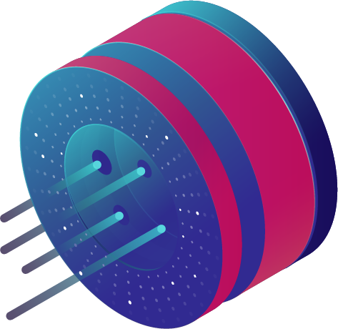
Mission #8: Release Gates

Slide 57
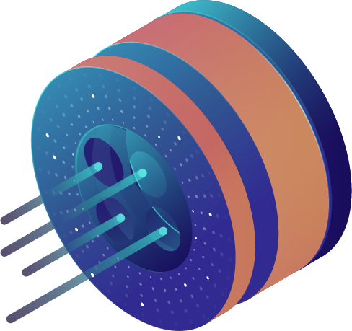
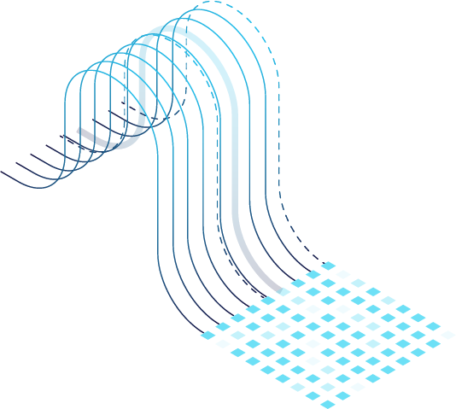
Mission #8: Release Gates

Slide 58
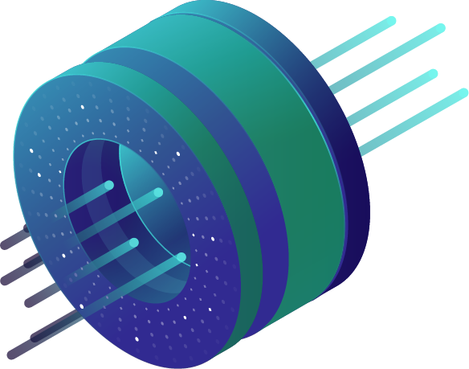
Mission #8: Release Gates

Slide 59
Mission #8: Release Gates
EVALUATION
GATES SUCCESS, DEPLOYMENT APPROVED
APPROVE
FAIL
FAIL
PASS
FAIL
FAIL
PASS
GATE 1
GATE 2
PASS
FAIL
PASS
PASS
PASS
PASS
GATE 3
FAIL
FAIL
PASS
PASS
PASS
PASS
SAMPLING INTERVALS
STABILIZATION TIME
TIMEOUT

Slide 60
Mission #8: Release Gates
EVALUATION
GATES SUCCESS, DEPLOYMENT REJECTED
REJECT
FAIL
FAIL
PASS
FAIL
FAIL
PASS
PASS
PASS
PASS
PASS
GATE 1
GATE 2
PASS
FAIL
PASS
PASS
PASS
FAIL
FAIL
FAIL
FAIL
FAIL
GATE 3
FAIL
FAIL
PASS
PASS
PASS
PASS
PASS
PASS
PASS
PASS
SAMPLING INTERVALS
STABILIZATION TIME
TIMEOUT

Slide 61
Kaya Records 2.0
DevOps Excellence
Moved from monthly deployments to the ability to deploy multiple times per day
Value-driven, autonomous teams
Core application running in the public cloud
Telemetry and reporting enabled to maximize efficiency

Slide 62
Final Assessment
What is Next?
Application Upgrade – UX/MD
System Architecture – API(s)
System Architecture – Microservices / Containers
System Architecture – Serverless
Subscription Service
Other Tech-based Revenue Streams

Slide 63
Conclusion

Slide 64
DevOps is a Transformation
3 Pillars
Leadership
Communication

Slide 65
Building a Culture of Excellence
Excellence in DevOps, as all things, can start anywhere in the organization and radiate out.
Build empowered, self-organizing teams.
Hoard blame.
Share credit.

Slide 66
More Information
www.transphormtech.com
Technology Transformation Advisory Services
www.mack24x7.com
Leadership and Technology Blog
Social: @mack24x7
LinkedIn: www.linkedin.com/in/joemack

